Slide 1

Python
Introduction
Variables
Data Types
Operators
Input and Output functions
Conditional constructs
Loop Constructs
Functions

Slide 2

Features
Created by Guido van Rossum in early 1990s.
High-level, interpreted, general-purpose language used in web, data science, AI, and more.
Emphasizes readability and simplicity.
Python code runs line-by-line via an interpreter—no separate compilation step.
Interactive shell lets you try commands and see immediate results.

Slide 3

Why Python
Data Analysis - Widely used in data-driven industries for processing and analyzing large datasets. (Core libraries: Pandas and NumPy)
Data Visualization - Transforms raw data into clear, insightful visuals.(Key libraries: Matplotlib and Seaborn)
Python for Machine Learning - AI and ML development due to its simplicity and power. (Libraries like scikit-learn, TensorFlow, Keras, and PyTorch) enable model building and deployment.
User friendly Language – Ease of Use

Slide 4
Compiler vs Interpreter
Sl No. | Compiler | Interpreter
1. | Compiler converts the source code to Machine Code. | Linking of files or generation of Machine Code is not required by Interpreter.
2. | Linking of various code files into a runnable program. | Execution of source statements one by one.
3. | The compiler saves the Machine Language in form of Machine Code on disks. | Execution of source statements one by one.
4. | Compiled codes run faster than Interpreter. | Interpreted codes run slower than Compiler.

Slide 5
Compiler vs Interpreter
5. | The compiler generates an output in the form of (.exe). | The interpreter does not generate any output.
6. | Any change in the source program after the compilation requires recompiling the entire code. | Any change in the source program during the translation does not require retranslation of the entire code.
7. | Errors are displayed in Compiler after Compiling together at the current time. | Errors are displayed in every single line.
8. | It does not require source code for later execution. | It requires source code for later execution.
9. | C, C++, C#, etc are programming languages that are compiler-based. | Python, Ruby, Perl, SNOBOL, MATLAB, etc are programming languages that are interpreter-based.

Slide 6
Python Modes
Sl No. | Interactive Mode | Script Mode
1. | A way of using the python interpreter by typing commands & expressions at any prompt. | A way of using the python interpreter to read & execute statements in a script.
2. | Can’t save and edit the code. | Can save and edit the code.
3. | If we want to experiment with the code, we can use interactive mode. | If we are clear about the code, use script mode.
4. | We cannot save the statements for further use and we have to retype them. | We can save the statements for further use and no need to retype all the statements to return them.

Slide 7

What Are Variables in Python?
A variable is a name that stores a value in a program, like a container for data.
Python is a dynamically typed language.
Python automatically infers the type based on the value you assign.
This flexibility makes Python code often more concise and quicker to write.

Slide 8
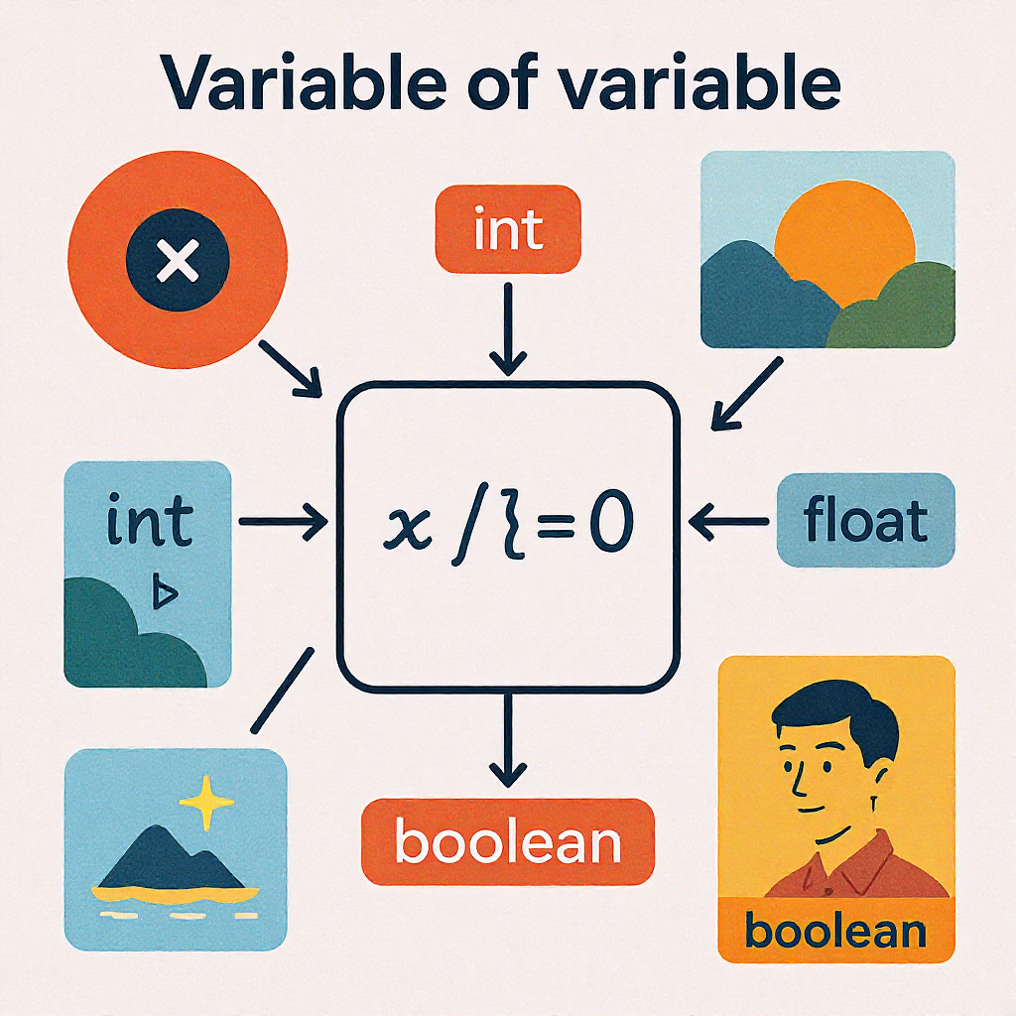
What Are Variables in Python?
Example Variable Assignments:
name = "Alice" (assigns a string)
age = 30 (assigns an integer)
height = 5.9 (assigns a float)
is_student = True (assigns a boolean)

Slide 9
Data Types
Data Types in Python
Numbers
Sequences
Sets
None
Mappings
Integers
Complex
Strings
Floating Point
Dictionaries
Lists
Tuples
Boolean

Slide 10
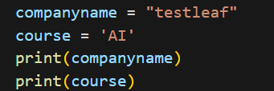
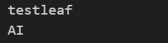
String Data Type
String is a group of characters (Alphabets, digits or special characters including spaces). String values are enclosed either in ‘ ’ or “ ”
Program:
Output:

Slide 11
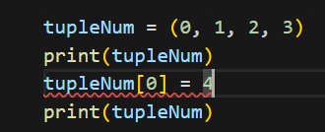
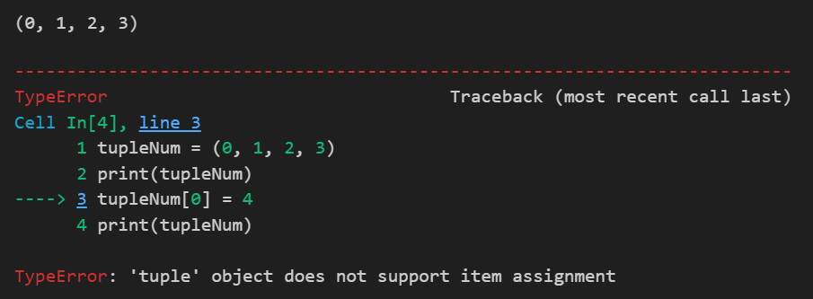
Tuple Data Type
Tuple is a sequence of items separated by commas and items are enclosed in parenthesis ( ). Once created, we cannot change items in the tuple. Similar to List, items may be of different data types.
Program:
Output:
Immutable

Slide 12
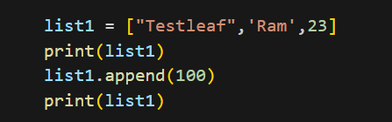
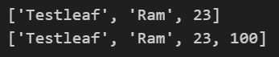
List Data Type
List is a sequence of items separated by commas and items are enclosed in square brackets [ ]. List items may be of different date types.
Program:
Mutable
Output:

Slide 13
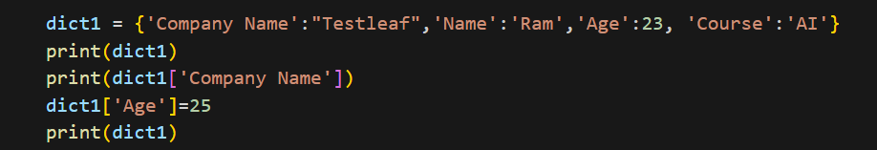
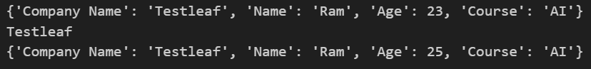
Mapping Data Type
Mapping is an unordered data type in Python. Only one standard mapping data type in Python called Dictionary.
Dictionary holds data items in key-value pairs and enclosed in curly brackets { }
Dictionaries permit faster access to data
Every key is separated from its value using a colon (:) sign
Keys are usually of string type and their values can be of any data type
Program:
Output:
Mutable

Slide 14
Operators
Sl No. | Type | Operators
1. | Arithmetic Operators | +, -, *, /, %, **
2. | Relational Operators | <, <=, >, >=, ==, !=
3. | Logical Operators | AND, OR, NOT
4. | Assignment Operators | =, +=, -=, *=, /=
5. | Member Operators | in, not in

Slide 15
Input Function
Taking input in Python
Python's input() function is used to take user input. By default, it returns the user input in form of a string.
name = input("Enter your name: ")
print("Hello,", name, "! Welcome!")

Slide 16
Output Function
Printing Output using print()
print("Hello, World!")
# Single variable
s = “Test Leaf"
print(s)

Slide 17
Formatted String Literal
f in a print statement, when placed directly before the opening quotation mark of a string literal (e.g., f"..."), signifies that the string is an f-string, also known as a formatted string literal
Use of f-strings is to provide a concise and readable way to embed expressions and variables directly within string literals
Variable Interpolation: You can directly embed variables within the string by enclosing them in curly braces {}
Python will evaluate these variables at runtime and insert their values into the string
name = “Ram" age = 20
print(f“ My name is {name} and I am {age} years old.")
price = 12.25
quantity = 5
print(f "The total cost is ${price * quantity:.2f}")
# Calculates and formats to 2 decimal places

Slide 18
Type Casting
Converts the input to an integer using typecasting and then prints the integer value.
# Taking input as int
# Typecasting to int
n = int(input("How many pens ?: "))
print(n)

Slide 19
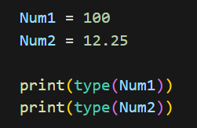
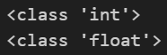
Type ()
To determine the data type of the variable using built-in function type()
Program:
Output:

Slide 20
Conditional Constructs
The primary conditional structures in Python are :
If
If…else
If…else..elif (short for "else if").
These keywords are used in conjunction with logical expressions that evaluate to either True or False.
Indentation is crucial in Python to define code blocks under each conditional statement. All lines belonging to an if, elif, or else block must be indented consistently.
Condition
Conditional Code
Else Code
Next step

Slide 21
Loop Constructs
Why Loops Matter in Python
Core Functionality
Indispensable for data analysis, system automation, and designing robust algorithms.
Automate Efficiency
Execute repetitive tasks with minimal code, saving time and reducing errors in complex operations.
Iterate Data
Seamlessly process elements within diverse data collections like lists, strings, and dictionaries.

Slide 22
For Loop
Syntax
for item in sequence:
The for loop is ideal for iterating over known sequences.
Versatility
Works seamlessly with various Python data structures, including lists, tuples, strings, sets, and even dictionaries.
Imagine you have a list of fruits and you want to print each one. A for loop makes this simple and concise.
Fruits = [“apple”, “banana”, “cherry”]
For fruit in Fruits :
Print(fruit)

Slide 23
range()
The range() is a built-in function in Python.
Syntax: range([start], stop[, step]).
It is used to create a list containing a sequence of integers from the given start value upto stop value (excluding stop value), with a difference of the given step value.
Start value not specified - list starts from 0.
Step is not specified - Value is incremented by 1 in each iteration.

Slide 24
While Loop
A while loop in Python is a control flow statement that repeatedly executes a block of code as long as a specified condition remains true.
The loop continues to iterate until the condition evaluates to False
while (count<5):
print(count)
count+=1
else:
print("In else",count)

Slide 25
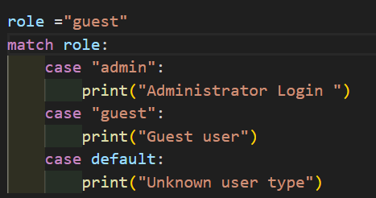
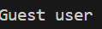
Match case statement
The match statement used to perform structural pattern matching, offering a more expressive and readable format
It is an alternative to if/elif/else statements

Slide 26
Control Flow Statement
Control flow statements used within loops to alter their execution
break
continue
break statement is used to terminate the current loop entirely.
break is encountered, the loop immediately stops, and the program's control flow moves to the statement immediately following the loop
.
The loop continues to iterate until the condition evaluates to False
while (count<5):
print(count)
count+=1
else:
print("In else",count)

Slide 27
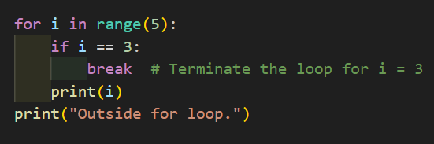
break Statement
break statement is used to terminate the current loop entirely.
break is encountered, the loop immediately stops, and the program's control flow moves to the statement immediately following the loop
Program:
Output:

Slide 28
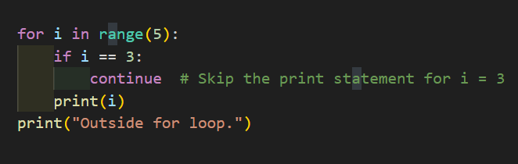
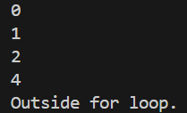
Continue Statement
continue statement is used to skip the rest of the code within the current iteration of a loop and proceed to the next iteration.
It does not terminate the loop but rather moves the control flow back to the beginning of the loop for the next iteration
Program:
Output:

Slide 29
List Slicing
List Slicing in Python : A quick way to access parts of a list
Slicing means extracting a portion of a list using index positions.
Syntax:
list[start:end:step]
start → index to begin (default = 0)
end → index to stop (not included)
step → jump size (default = 1)
Example :
numbers = [10, 20, 30, 40, 50, 60]
print(numbers[1:4]) # [20, 30, 40]
print(numbers[:3]) # [10, 20, 30]
print(numbers[3:]) # [40, 50, 60]

Slide 30
List Slicing
Using Step :
numbers = [10, 20, 30, 40, 50, 60]
print(numbers[::2]) # [10, 30, 50]
print(numbers[1::2]) # [20, 40, 60]
Negative Index Slicing :
numbers = [10, 20, 30, 40, 50, 60]
print(numbers[-3:]) # [40, 50, 60]
print(numbers[::-1]) # [60, 50, 40, 30, 20, 10] (reversed)

Slide 31
List Functions
len(list) → Returns length
max(list), min(list) → Largest/smallest
sum(list) → Adds all numbers
Example:
len([10,20,30]) # 3
max([10,20,30]) # 30
sum([10,20,30]) # 60

Slide 32
Modifying Lists
append() → Add element
insert() → Insert at index
remove() → Remove first match
pop() → Remove element at index
Example:
nums = [1,2]
nums.append(3) → [1,2,3]
nums.insert(1,5) → [1,5,2,3]

Slide 33
Searching and Sorting
index() → Find index of element
count() → Count occurrences
sort() → Sort ascending
reverse() → Reverse list
Example:
nums = [3,1,2]
nums.sort() → [1,2,3]
nums.reverse() → [3,2,1]
nums.index(3)

Slide 34
✅ list[start:end:step] → slicing pattern
✅ Default values: start=0, end=len(list), step=1
✅ Negative indices help access from end
✅ Functions make list handling easier
✅ Combine slicing + functions for flexibility

Slide 35
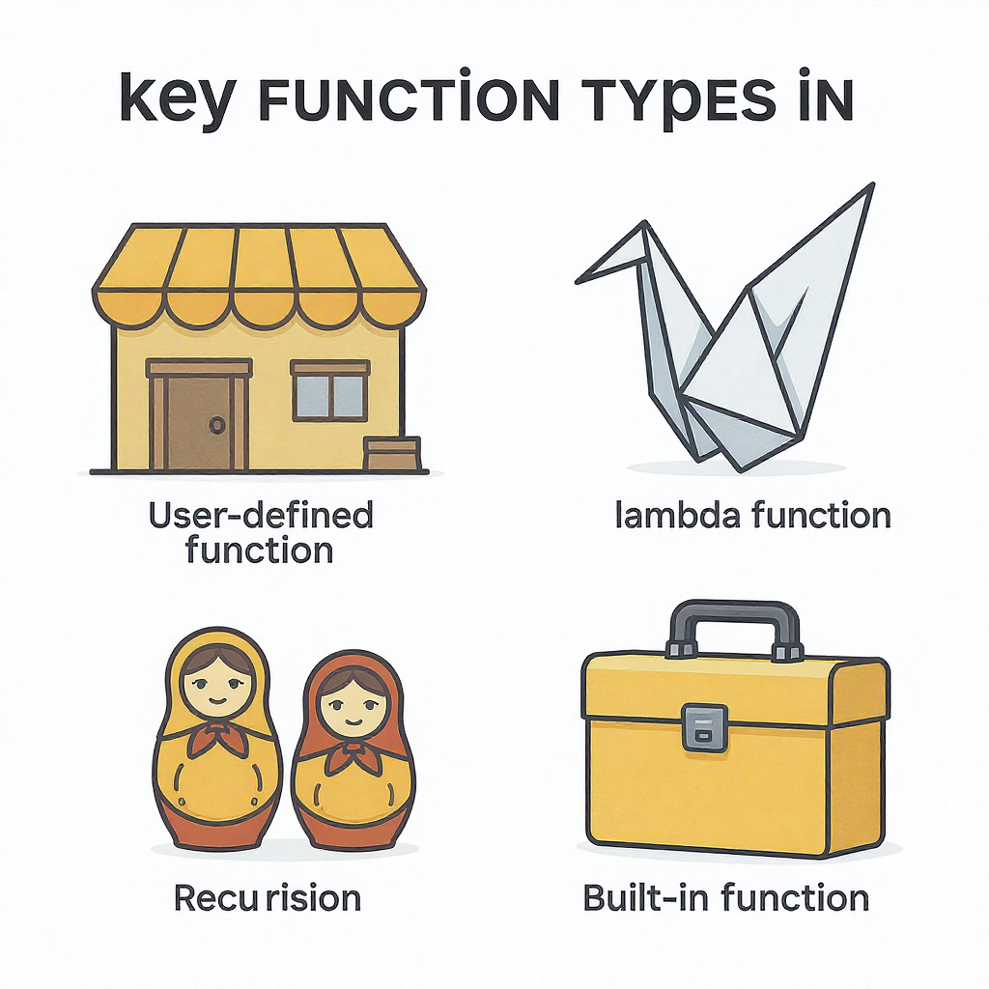
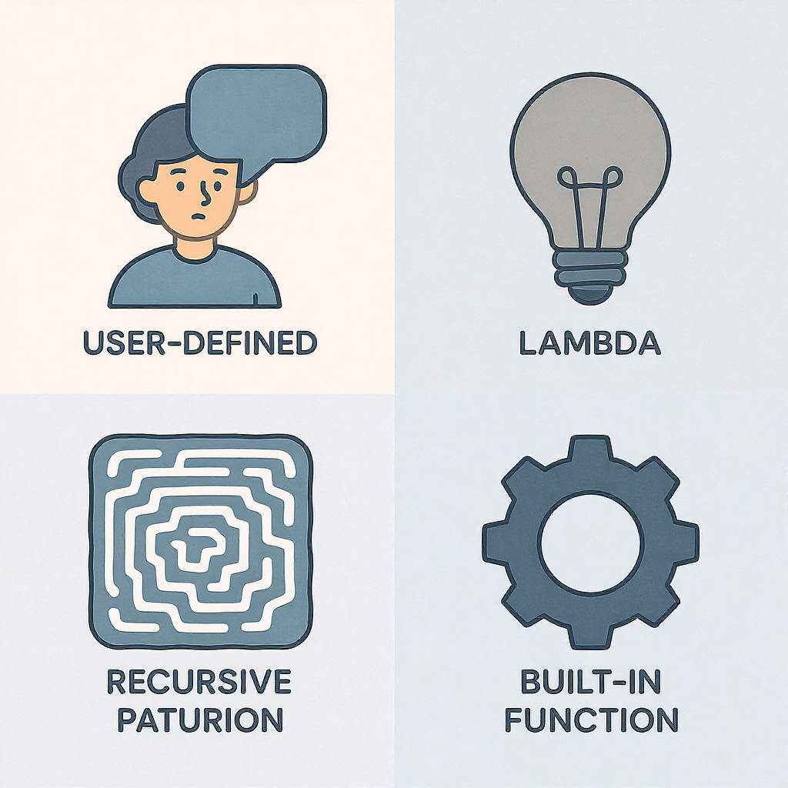
Functions
A function in Python is a defined block of organized, reusable code that performs a single, related action
Functions provide better modularity for your application and a high degree of code reusing

Slide 36
Functions
Defining and Calling Functions
01
02
03
Define with def
Start with the def keyword, followed by the function name and parentheses. This marks the beginning of your function block.
def my_function():
pass
Add Function Logic
Indent the code you want to execute inside the function. This code will only run when the function is explicitly called.
def greet():
print("Hello!")
Call to Execute
Execute the function by writing its name followed by parentheses. This triggers the code within the function to run.
greet()
Output: Hello!

Slide 37
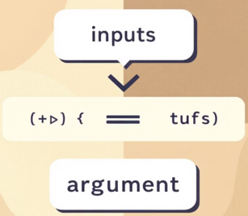
Functions
Multiple Arguments and Parameter Rules
Python functions can take any number of arguments, allowing for complex operations. Each argument should be separated by a comma in the function definition.
When calling the function, you must provide values for all defined arguments.
The order of arguments matters; values are assigned to parameters based on their position.
Mismatching the number of arguments will result in a TypeError.
def add(a, b):
return a + b
result = add(3, 4)
print(result)
Output: 7

Slide 38
Types of Functions Arguments
Function Arguments
Positional Arguments
Keyword Arguments
Arbitrary Arguments
Default Arguments

Slide 39
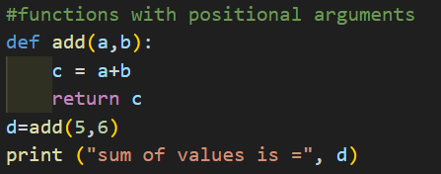
Positional Arguments
Arguments passed to a function should be in correct positional order.
The number of arguments in the function call should match exactly with the function definition, otherwise the code gives a syntax error.
Program:
Output:

Slide 40
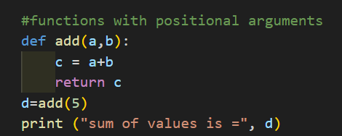
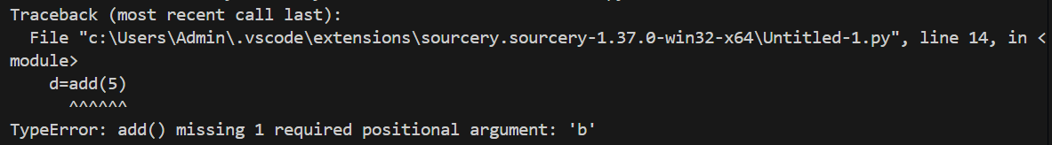
Positional Arguments
Mismatch in arguments code throws type error
Program:
Output:

Slide 41
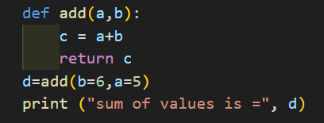
Keyword Arguments
The caller identifies the arguments by the parameter name.
This allows to place the arguments out of order because the Python interpreter is able to use the keywords provided to match the values with parameters.
Program:
Output:

Slide 42
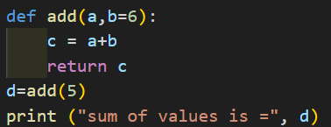
Default Arguments
It is used if no arguments are passed to the function call.
default value assigned to one or more arguments.
It uses the default value for such an argument if no value is passed to it.
If any value is passed, the default value is overridden with the actual value passed.
Program:
Output:

Slide 43
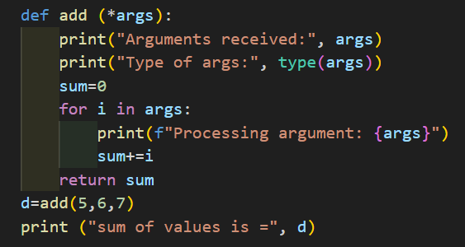
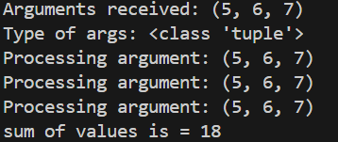
Arbitrary Positional Arguments
Program:
Functions which accepts arbitrary or variable number of arguments.
An argument prefixed with a single asterisk * for arbitrary positional arguments.
The args variable prefixed with "*" stores all the values passed to it.
args becomes a tuple
Output:

Slide 44
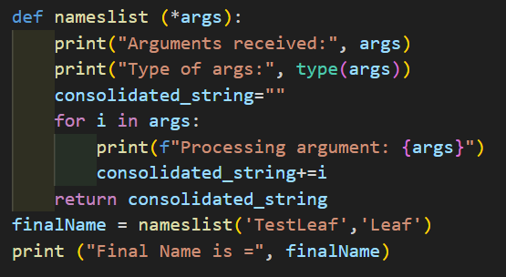
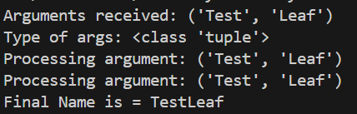
Arbitrary Positional Arguments
Program:
Output:

Slide 45
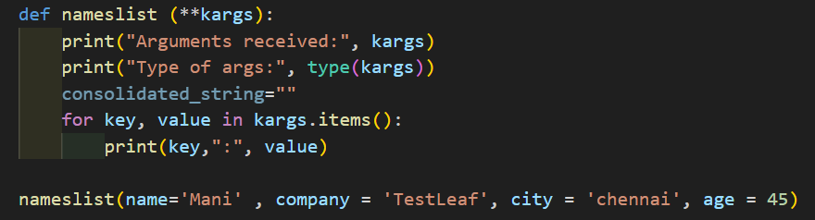
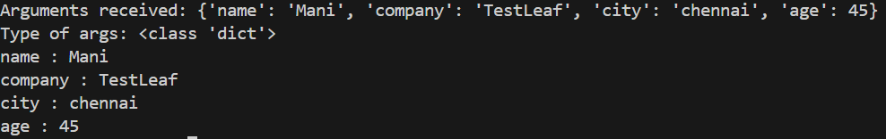
Arbitrary Keyword Arguments
Program:
An argument prefixed with two asterisks ** for arbitrary keyword arguments.
Function can accept arbitrary number of keyword arguments.
The variable is a dictionary of keyword:value pairs.
Output:

Slide 46
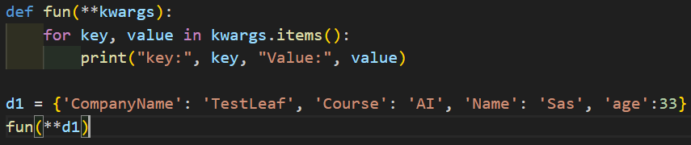
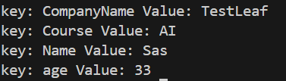
Arbitrary Keyword Arguments
Program:
Output:

Slide 47
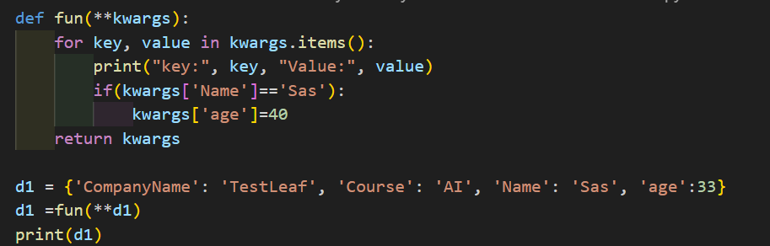
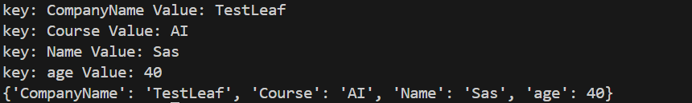
Arbitrary Keyword Arguments
Program:

Slide 48
Built-In Functions - List
Method | Description
append() | Element is added to the end of the list.
copy() | Returns a copy of the list.
clear() | Removes all elements from the list
count() | Returns the number of times a specified element appears in the list.
extend() | Adds elements from another list to the end of the current list
index() | Returns the index of the first occurrence of a specified element.
indexinsert() | Inserts an element at a specified position
remove() | Removes the first occurrence of a specified element.
reverse() | Reverses the order of the elements in the list
sort() | Sorts the list in ascending order
pop() | Removes and returns the element at the specified position (or the last element if no index is specified)

Slide 49
Built-In Functions - Dictionary
Method | Description
clear() | Removes all the elements from the dictionary
copy() | Returns a copy of the dictionary
fromkeys() | Returns a dictionary with the specified keys and value
get() | Returns the value of the specified key
items() | Returns a list containing a tuple for each key value pair
keys() | Returns a list containing the dictionary's keys
pop() | Removes the element with the specified key
popitem() | Removes the last inserted key-value pair
setdefault() | Returns the value of the specified key. If the key does not exist: insert the key, with the specified value
update() | Updates the dictionary with the specified key-value pairs
values() | Returns a list of all the values in the dictionary

Slide 50
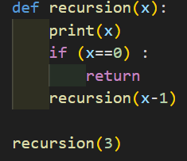
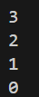
Recursive Functions
A recursive function is a function that calls itself, during its execution.
This technique is used to solve problems that can be broken down into smaller, subproblems.
Program:
Output:

Slide 51
Lambda Functions
Lambda functions do not require a name and can only contain a single expression, which is implicitly returned
Used for defining simple functions
Program:
Output:

Slide 52
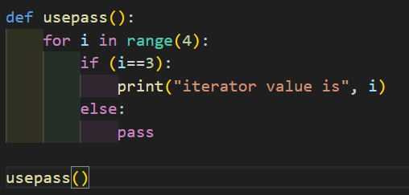
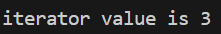
Placeholders - Pass
pass statement in Python is a null operation
It does nothing when executed
Purpose is to act as a placeholder where a statement is syntactically required but no actual code or logic is intended

Slide 53
Placeholders – Single underscore
Use of “-” temporary or throwaway variable
Placeholder when the variable itself is not going to be used in the code
for _ in range(4):
print(“TestLeaf")
def return_numbers():
return 10, 20
_, num2value = return_numbers() ➔ # Ignoring the first element of the returned pair using a single underscore
print("Value:", num2value)

Slide 54
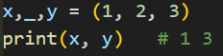
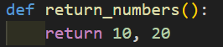
Placeholders – Single underscore
Single underscore variable

Slide 55
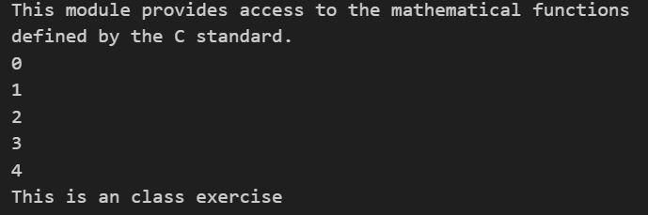
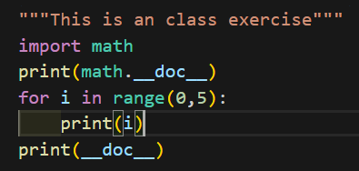
Dunder Variable
Double underscore variable - these variables are always surrounded by two underscores
Pythons internal Use, don’t try to define dunder variables
To convey information to Python programmers
To empower Python programmers to convey information to the Python interpreter
print(__name__) ➔ This prints the current context of the file
print(__doc__) ➔ This prints the document comment of the file

Slide 56
Importing Module
A file containing a set of functions required to include in your application
To create a module → Save the code you want in a file with the file extension .py
Use the module created, by using the import statement
Renaming module name while importing → import base as b

Slide 57
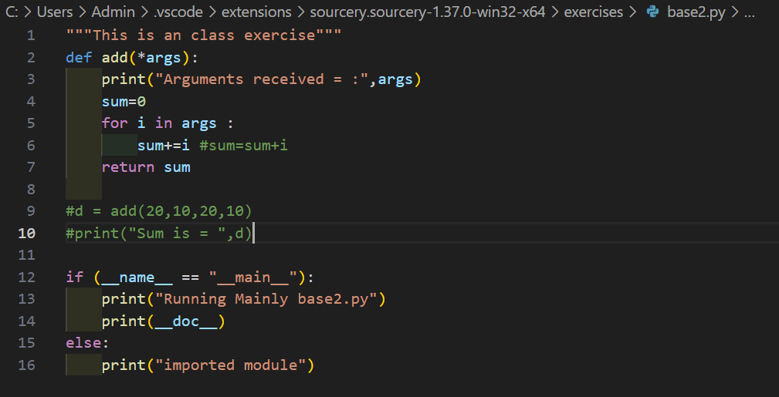
Importing Module – Base file
Base file with functions defined

Slide 58
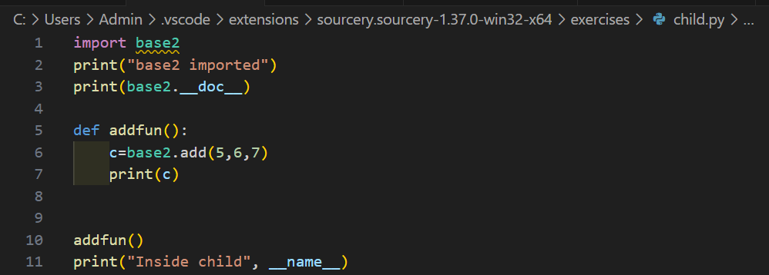
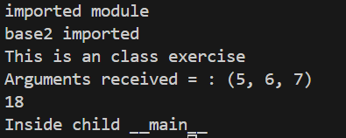
Importing Module – Base file to child file
Child file where the base file is getting imported

Slide 59
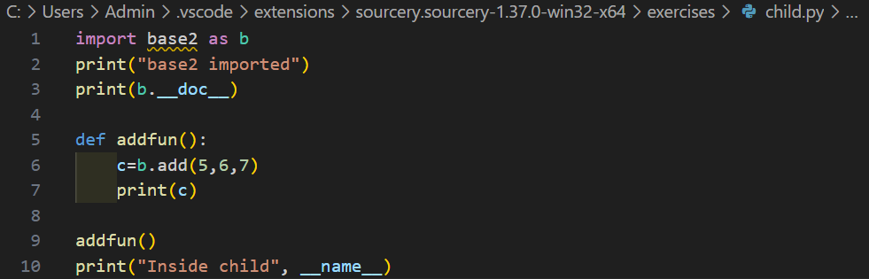
Renaming Module
Renaming module name while importing → import base as b
Create an alias when you import a module, by using the as keyword

Slide 60
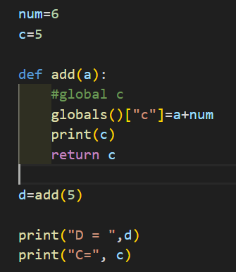
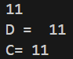
Global Variables
Global variable is a variable defined at the module level, accessible throughout the program.
Creating global variables inside a function
Program
Output

Slide 61
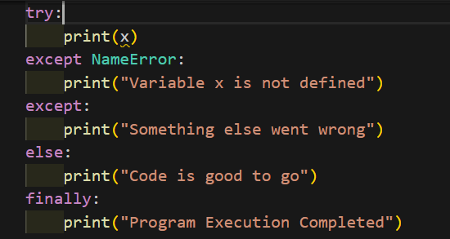
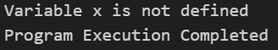
Try and Except
try block - check for block of code for errors
except block – Handles the error.
else block - Execute code when there is no error.
finally block - Execute code, regardless of the result of the try- and except blocks.
Program
Output

Slide 62
Object Oriented Concepts
Object-Oriented Programming (OOP)
Python is an object-oriented language, allowing you to structure your code using classes and objects for better organization and reusability.
Why OOP?
Provides a clear structure to programs
Makes code easier to maintain, reuse, and debug
Not to repeat the code
Allows you to build reusable applications with less code
The ability to add new features or expand functionality by creating new classes or extending existing ones.

Slide 63


Object Oriented Concepts
Class: The Blueprint
A class defines the properties (attributes) and behaviors (methods) that all objects of that type will have. It's a template, not a real thing.
Object: The Instance
An object is a specific, real-world instance of a class. It has actual values for its properties and can perform the behaviors defined by its class. For example, your red Toyota Corolla, driving at 60 mph.

Slide 64

Object Oriented Concepts
Encapsulation is the practice of bundling data (attributes) and the methods that operate on that data into a single unit, the object. It's like creating a protective shell around your data.
Data Hiding
Internal state of an object is hidden from the outside world.
Controlled Access
Data can only be accessed or modified via defined public methods.
This prevents unintended interference and ensures data integrity, much like a medicine capsule protects its contents until the right moment for release.

Slide 65
Object Oriented Concepts
Encapsulation is the practice of bundling data (attributes) and the methods that operate on that data into a single unit, the object. It's like creating a protective shell around your data.
Data Hiding
Internal state of an object is hidden from the outside world.
Controlled Access
Data can only be accessed or modified via defined public methods.
This prevents unintended interference and ensures data integrity, much like a medicine capsule protects its contents until the right moment for release.

Slide 66



Object Oriented Concepts
Inheritance: Reusing and Extending Code
Inheritance is a powerful OOP concept that allows a new class (child or subclass) to inherit properties and behaviors from an existing class (parent or superclass). This promotes code reuse and establishes a hierarchical relationship.
Defines common traits for all animals (e.g., `eat()`, `sleep()`, `age`).
Child Class: Dog
Child Class: Cat
Inherits from Animal, and adds specific behaviors like `bark()` or `fetch()`. A Dog IS-A Animal.
Also inherits from Animal, adding its own unique behaviors such as `meow()` or `purr()`. A Cat IS-A Animal.
This "IS-A" relationship is fundamental to building organized and maintainable codebases.

Slide 67



Object Oriented Concepts
Polymorphism: One Interface, Many Forms
Polymorphism means "many forms." In OOP, it refers to the ability of different classes to respond to the same method call in unique ways. It simplifies programming by allowing you to use a single interface for different data types.
Dog's Sound
Cat's Sound
Cow's Sound
If you call `makeSound()` on a Dog object, it will `bark()`.
If you call `makeSound()` on a Cat object, it will `meow()`.
If you call `makeSound()` on a Cow object, it will `moo()`.
Despite being different animals, they all respond to the `makeSound()` instruction, each in their own characteristic way. This makes code more flexible and easier to extend.

Slide 68
Object Oriented Concepts -Polymorphism
Polymorphism enables writing generic code that can operate on objects of various types, as long as those objects conform to a particular interface (i.e., they implement the same method names).
This reduces code duplication and makes the system more adaptable to changes or additions of new

Slide 69
Object Oriented Concepts
How to do Object-Oriented Programming ?
Create Class
Create Objects
Access Class Members.
Class it a template / blueprint – Binds the data and its associated methods
An object is an instance of a class
Once a class is created, we can create any number of object instances
Class is a collection of Objects

Slide 70


Object Oriented Concepts
__init__ is a special method within a class, often referred to as the constructor. Its primary purpose is to initialize the attributes (or properties) of a newly created object when an instance of a class is made.
Program
Output

Slide 71
Method Resolution Order (MRO)
Method Resolution Order (MRO) defines the sequence in which Python searches for methods and attributes in a class hierarchy, especially in scenarios involving multiple inheritance.
It dictates the order in which base classes are examined when a method or attribute is accessed on an object.
When a method is called on an object, Python first looks for it in the object's own class.
If not found, it proceeds to search in the parent classes listed in the class definition from left to right, and then recursively up the inheritance chain of each parent, ensuring that no class is visited more than once.

Slide 72
Multilevel & Multiple Inheritance
MultiLevel Inheritance
Base class (Parent1 Class)
Base class (Parent2 Class)
Derived class (Child Class)
Derived class1 (Child1 Class)
Derived class (Child Class)
Multiple Inheritance
Derived class2 (Grand Child Class)
Derived
class
Derived class3 (Grand Grand Child Class)

Slide 73
Class 1 :
a = 10
display()
Class2 (Class1)
a = 10 -> Inherited from class 1
display() -> Inherited from class 1
B=10 -> Class 2 data variable
Show() – Class 2 Method
Person → Profession→ Experience
Person.Constructor
Professional.Constructor
Person
Profession
Expereince
Experience. Constructor
Instances
P1
P2

Slide 74
File Handling
File handling refers to the process of performing operations on a file, such as creating, opening, reading, writing and closing it through a programming interface.
It involves managing the data flow between the program and the file system on the storage device, ensuring that data is handled safely and efficiently.

Slide 75
Why File Handling
To store data permanently, even after the program ends.
To access external files like .txt, .csv, .json, etc.
To process large files efficiently without using much memory.
To automate tasks like reading configs or saving outputs.
To handle input/output in real-world applications and tools

Slide 76
File Handling – Open()
file = open(“Sample.txt", "r")
# Perform file operations
file.close()
The file.close() method closes the file and releases the system resources. If the file was opened in write or append mode, closing ensures that all changes are properly saved.

Slide 77
File Handling – Close()
The file.close() method closes the file and releases the system resources. If the file was opened in write or append mode, closing ensures that all changes are properly saved.
file = open(“Sample.txt", "r")
# Perform file operations
file.close()
Using with Statement
Instead of manually opening and closing the file, you can use the with statement, which automatically handles closing. This reduces the risk of file corruption and resource leakage.

Slide 78


File Properties

Slide 79

file.read()
Reading a file can be achieved by file.read()
Reads the entire content of the file.
After reading, it’s good practice to close the file to free up system resources.

Slide 80

file.write()
Writing is done using the mode "w".
This creates a new file if it doesn’t exist, or overwrites the existing file if it does.
The write() method is used to add content. After writing, make sure to close the file.

Slide 81

Introduction to NumPy
What is NumPy?
NumPy is a Python library.
NumPy is used for working with arrays.
NumPy is short for "Numerical Python".

Slide 82
Introduction to NumPy
What is NumPy?
NumPy (Numerical Python) is a powerful library for numerical computing in Python.
Provides support for large, multi-dimensional arrays and matrices.
Includes a collection of mathematical functions to operate on these arrays.

Slide 83
Introduction to NumPy
20
0 - dimensional
Collection of 0-dimensional
20,30,40,50
1 - dimensional
Collection of two 1-dimensional
[20,30,40]
[11,12,33]
2 - dimensional
Collection of two or more 2-dimensional
3 - dimensional

Slide 84
Introduction to NumPy
What is NumPy?
Python we have lists that serve the purpose of arrays, but they are slow to process.
NumPy aims to provide an array object that is up to 50x faster than traditional Python lists.
The array object in NumPy is called ndarray, it provides a lot of supporting functions that make working with ndarray very easy.
Arrays are very frequently used in data science, where speed and resources are very important.

Slide 85


Slide 86

Why Use NumPy?
Faster computations compared to Python lists.
Memory-efficient due to typed arrays.
Simplifies complex mathematical operations.
Basic Operations
Array creation: np.array([1, 2, 3])
Mathematical operations: np.add, np.dot, etc.
Indexing and slicing: Access specific elements or subarrays.

Slide 87

Applications
Data analysis and manipulation.
Machine learning and AI.
Scientific simulations and research.

Slide 88
j = 0
j = 1
j = 2
twodarr
twodarr[i][j]
[[ 1 2 3]
[ 4 5 6]]
i = 0
i = 1
I | J | Value
0 | 0 | 1
0 | 1 | 2
1 | 1 | 5
1 | 0 | 4

Slide 89
k = 0
k = 1
k = 2
threedarr
threedarr[i][j][k]
[[[ 1 2 3]
[ 4 5 6]]
[[11 12 13]
[14 15 16]]]
j = 0
i = 0
j = 1
I | J | k | Value
0 | 0 | 0 | 1
0 | 1 | 2 | 6
1 | 1 | 1 | 15
1 | 0 | 2 | 13
j = 0
i = 1
j = 1
k = 0
k = 1
k = 2

Slide 90
Copy And View
The copy owns the data and any changes made to the copy will not affect original array, and any changes made to the original array will not affect the copy.
The view does not own the data and any changes made to the view will affect the original array, and any changes made to the original array will affect the view.

Slide 91
Shape And Reshape
NumPy arrays have an attribute called shape
that returns a tuple with each index having the number of corresponding elements.
import numpy as np arr1 = np.array([[11, 12, 13, 14], [15, 16, 17, 18]]) print(arr1.shape) #(2, 4)

Slide 92

Reshape
Reshaping means changing the shape of an array.
The shape of an array is the number of elements in each dimension.
By reshaping we can add or remove dimensions or change number of elements in each dimension.
import numpy as np arr_sample = np.array([1, 2, 3, 4, 5, 6, 7, 8, 9, 10, 11, 12]) newarr = arr_sample.reshape(4, 3) print(newarr)

Slide 93
Iteration
In a 2-D array it will go through all the rows
arr = np.array([[1, 2, 3], [4, 5, 6]])
for x in arr:
print(x)
[1 2 3]
[4 5 6]

Slide 94


Join
Joining means putting contents of two or more arrays in a single array.
SQL, Tables joined based on a key, whereas in NumPy we join arrays by axes.
We pass a sequence of arrays that we want to join to the concatenate() function, along with the axis. If axis is not explicitly passed, it is taken as 0.

Slide 95
Searching Arrays
You can search an array for a certain value, and return the indexes that get a match.
To search an array, use the where() method.
arr = np.array([1, 6, 3, 6, 5, 7, 6, 6])
x = np.where(arr == 6)
print(x)
(array([1, 3, 6, 7]),)

Slide 96
Sorting and Filter
Ordered sequence is any sequence that has an order corresponding to elements, like numeric or alphabetical, ascending or descending.
The NumPy ndarray object has a function called sort(), that will sort a specified array.
arr = np.array([1, 6, 3, 6, 5, 7, 6, 6])
x = np.sort(arr)
print(x)

Slide 97
Filter
Getting some elements out of an existing array and creating a new array out of them is called filtering.
A boolean index list is a list of booleans corresponding to indexes in the array.
arr2 = np.array([41, 42, 43, 44])
x = [True, False, True, False]
newarr = arr2[x]
print(newarr)
[41 43]

Slide 98
Arithmetic Operations
We could use arithmetic operators + - * / directly between NumPy arrays, using functions
arr1 = np.array([10, 11, 12, 13, 14, 15]) arr2 = np.array([20, 21, 22, 23, 24, 25]) newarr1 = np.add(arr1, arr2)
newarr2= np.subtract(arr1, arr2)
newarr3 = np.multiply(arr1, arr2)
newarr4 = np.divide(arr1, arr2) print(newarr1)
print(newarr2)
print(newarr3)
print(newarr4)

Slide 99
Other functions
The power() function rises the values from the first array to the power
of the values of the second array, and return the results in a new array.
Summation : Addition is done between two arguments whereas summation happens over n elements.
newarr = np.sum(arr1,arr2)
Difference: A discrete difference means subtracting two successive elements.
newarr = np.diff(arr)
Product: Find the product of the elements in an array, use the prod() function.

Slide 100

Pandas
Introduction
Pandas (stands for PANel Data, Python Data Analysis), Created by Wes McKinney in 2008
It is an open-source software library designed for data manipulation and analysis.
Python package for for data manipulation and exploratory data analysis (EDA)
Pandas is a Python library used for working with data sets.
It has functions for analyzing, cleaning, exploring, and manipulating data.

Slide 101

Key Features of Pandas
High-level, intuitive data manipulation capabilities.
Built upon NumPy for numerical operations and integrates well with Matplotlib for visualization.
Facilitates easy data import from and export to various formats (CSV, Excel, SQL databases, JSON).
Supports comprehensive data analysis and visualization workflows.
Core data structures: Series, DataFrame, and the now-deprecated Panel.

Slide 102

Why Pandas is Indispensable for Data Professionals

Slide 103
Pandas vs. NumPy: Choosing the Right Tool
Data Types | Primarily handles homogeneous numerical data (e.g., all integers or all floats). | Excels with heterogeneous data, supporting mixed types like integers, floats, strings, and datetimes within the same structure.
Operations | Focuses on mathematical operations on arrays; file loading and grouping are often more complex. | Offers simpler and more streamlined operations for tasks like file loading, data joining, and grouping.
Data Tracking | Data is indexed numerically. | DataFrames inherently track data using meaningful column names, enhancing readability and usability.
Primary Use | Best for numerical array computations and scientific computing. | The go-to library for tabular data manipulation and analysis.

Slide 104

Seamless Setup: Installing Pandas
Getting started with Pandas is straightforward.
The primary prerequisite is a working Python installation on your system.
The most common and recommended way to install Pandas is via pip, Python's package installer.
Open your terminal or command prompt and execute the following command:
pip install pandas

Slide 105



Understanding Pandas Data Structures
Pandas introduces fundamental data structures that are key to its power and flexibility. These structures are optimized for efficiency and ease of use when working with structured data.
Series
DataFrame
Panel
A Series is a one-dimensional labeled array, akin to a single column in a spreadsheet or a SQL table. It can hold any data type.
The DataFrame is the most widely used Pandas object. It's a two-dimensional labeled data structure with columns of potentially different types, resembling a spreadsheet or database table.
Historically, Pandas included a Panel for three-dimensional data. However, this structure has been deprecated in favor of more explicit multi-index DataFrames or xarray for advanced use cases.

Slide 106

Deep Dive: The Pandas Series
What is a Series?
A Pandas Series is a one-dimensional array.
It comes with labeled indices, allowing for quick data retrieval and alignment.
Versatile in its content, a Series can hold any datatype: integers, floating-point numbers, strings, Python objects, and more.
The data label associated with a particular value is called its index. We can also assign values of other data types as index.
It behaves much like a single column from an Excel spreadsheet or a SQL table, providing both data and an associated index.

Slide 107

Example: Country Series
Consider a simple Series representing a list of countries with numerical indices:
This example clearly demonstrates how each value is associated with an index, making data access both intuitive and efficient.

Slide 108


Series Creation Using Scalar Values
A Series can be created using scalar values
We can imagine a Pandas Series as a column in a spreadsheet.
Series can be created using constructor. Syntax :- pandas.Series( data, index, dtype, copy)
Series can be created using 1. Array 2. Dict 3. Scalar value or constant

Slide 109

Creating a Series -custom Labels
Let's walk through a practical example of how to create a Pandas Series using Python. This snippet illustrates defining both data values and custom indices.
Program
Output
# Import pandas library
import pandas as pd
# Creating a Series with custom string indices
indices = pd.Series([10, 20, 30], index=['a', 'b', 'c'])
# Printing the Series to observe its structure
print(indices)

Slide 110


Example – Add custom labels

Slide 111


Create Series – Array

Slide 112
Series Creation Using Dictionary
This seamless conversion makes dictionaries an ideal starting point for creating indexed data structures in pandas.
Dictionary Keys → Index
Dictionary keys automatically become the Series index labels, providing meaningful row identifiers
Dictionary Values → Data
Dictionary values become the actual Series data, maintaining their original data types and structure
The Series automatically infers data types and creates a meaningful index from your dictionary keys.

Slide 113


Create Series – Dictionary

Slide 114
Series – head()
head() function in a Pandas Series returns the first n elements of the Series.
It is a useful method for quickly inspecting the beginning of a Series without needing to display the entire object.
import pandas as pd
s = pd.Series([10, 20, 30, 40, 80])
print("\nFirst 3 elements:")
print(s.head(3))
First 3 elements: 0 10 1 20 2 30 dtype: int64

Slide 115
Series – Builtin Functions
Viewing and inspection
Method | Description
s.head(n) | First n rows (default 5)
s.tail(n) | Last n rows (default 5)
s.info() | Concise summary (dtype, memory)
s.describe() | Descriptive statistics (count, mean, std, quartiles)

Slide 116
Calculation and statistics
Method | Description
s.sum() | Sum of values
s.mean() | Mean of values
s.median() | Median of values
s.max() | Maximum value
s.min() | Minimum value
s.abs() | Absolute values
s.prod() | Product of all elements
s.cumsum() | Cumulative sum
s.cumprod() | Cumulative product

Slide 117
Filtering and sorting
Method | Description
s.isin(values) | Check if each element is in values
s.sort_values() | Sort by values
s.sort_index() | Sort by index
s.drop_duplicates() | Remove duplicate values

Slide 118
Missing Data handling
Method | Description
s.isna() / s.isnull() | Detect missing values
s.dropna() | Remove missing values
s.fillna(value) | Fill missing values

Slide 119
Unique values and counts
Method | Description
s.unique() | Array of unique values
s.nunique() | Number of unique values
s.value_counts() | Count of unique values

Slide 120
Mathematical Operations
Method | Description
s.add(s1) | Addition of two series
s.sub(s1) | subtraction of two series
s.mul(s1) | Multiplication of two series
s.div(s1) | Addition of two series

Slide 121

DataFrames – Table Representation

Slide 122

Core components of pandas: Series & DataFrames
The primary two components of pandas are the Series and DataFrame.
Series is essentially a column, and
DataFrame is a multi-dimensional table made up of a collection of Series.
DataFrames and Series are quite similar in that many operations that you can do with one you can do with the other, such as filling in null values and calculating the mean.
A Data frame is a two-dimensional data structure, i.e., data is aligned in a tabular fashion in rows and columns.
columns
rows

Slide 123
Features of DataFrames
Features of DataFrame
Potentially columns are of different types
Size – Mutable
Labeled axes (rows and columns)
Can Perform Arithmetic operations on rows and columns

Slide 124

Introducing the Pandas DataFrame
The DataFrame is the most fundamental and powerful data structure in Pandas, representing data in a tabular format.
HETEROGENEOUS DATA:
Unlike NumPy arrays, DataFrames can store columns with different data types, such as numbers, strings, and boolean values, all within the same structure.
SIZE MUTABILITY:
DataFrames are dynamic; you can add or remove columns and rows after creation, allowing for flexible data manipulation.
DATA MUTABILITY:
The values within a DataFrame can be updated or modified at any time, providing complete control over your dataset.
Think of a DataFrame as a spreadsheet or a SQL table. For instance, a student data table with 'Name' (string), 'Class' (integer), and 'DOB' (datetime) columns is a perfect example of heterogeneous data handled effortlessly by a DataFrame.

Slide 125





Diverse Sources: Creating a DataFrame
Pandas DataFrames are incredibly versatile and can be constructed from a multitude of data sources, making them adaptable to various data collection scenarios.
From List
Create DataFrames directly from Python lists of lists, tuples, or dictionaries.
From Dict
Construct DataFrames from Python dictionaries where keys become column names and values are lists of data.
From Series
Combine multiple Pandas Series objects into a single DataFrame, where each Series acts as a column.
From NumPy Arrays
Leverage numerical data stored in NumPy arrays to form the foundation of a DataFrame.
From Other DataFrames
Merge or transform existing DataFrames to create new ones, facilitating complex data transformations.
Each method offers flexibility for different data input needs, from manual entry to importing from databases or files.

Slide 126
Methods for Data Inspection and Metadata
Method | Description
.head(n) | Returns the first n rows (default 5).
.tail(n) | Returns the last n rows (default 5).
.info() | Summary including data types, non-null counts, memory.
.describe() | Descriptive stats (count, mean, std, percentiles).
.shape | Tuple of (rows, columns).
.columns | Column labels of DataFrame.
.index | Row labels of DataFrame.
.dtypes | Data type of each column.

Slide 127
Methods for Data Selection and Filtering
Method | Description
.loc[] | Selects by label(s) or boolean condition.
.iloc[] | Selects by integer position.
df[column_name] | Selects a single column.
df[[col1, col2]] | Selects multiple columns.
.query(expression) | Filters using boolean expression.

Slide 128
Methods for Data Cleaning and Preparation
Method | Description
.fillna(value) | Fill missing values with value or method.
.dropna() | Removes missing values (rows/columns).
.drop(labels, axis) | Removes rows/columns by label.
.rename(columns={...}) | Renames specified columns.
.astype(dtype) | Casts column to given data type.
.replace(to_replace, value) | Replaces specific values.

Slide 129
Methods for Data Manipulation
Method | Description
.apply(func, axis) | Applies a function to rows/columns.
.applymap(func) | Function to every element (deprecated).
.groupby(by) | Groups data for aggregate functions.
.sort_values(by) | Sorts DataFrame by column values.
.merge(right, on) | SQL-style join of DataFrames.
.concat([df1, df2]) | Concatenates DataFrames.
.pivot_table() | Creates spreadsheet-style pivot table.

Slide 130
readcsv
To read a CSV file into a Pandas DataFrame, the read_csv() function is used.
This function is a core part of the Pandas library, which is widely used for data manipulation and analysis in Python.
# Read the CSV file into a DataFrame
df = pd.read_csv('emp_input.csv',usecols=['Name', 'Location'])
# Display the DataFrame
print("DataFrame read from CSV:")
print(df)

Slide 131
writecsv
To write a CSV file into a Pandas DataFrame, the to_csv() function is used.
To update the existing file use mode as “a”
empdata = {'Name': ['Alex', 'Steve', 'Charles'],
'Experience': [20, 15, 10],
'Location': ['Bangalore', 'Chennai', 'Delhi']}
emp_df = pd.DataFrame(empdata)
print(emp_df)
emp_df.to_csv('emp_input.csv', index=True) # Save withsout the DataFrame index
# Create a new DataFrame with data to append
new_data = {'Name': ['Ram', 'Sita'], 'Experience': [15, 20], 'Location': ['Bangalore', 'Chennai']}
df_new = pd.DataFrame(new_data)
# Append the new data to the existing CSV
df_new.to_csv('emp_input.csv', mode='a', header=False, index=False)

Slide 132
Matplotlib: Data Visualization in Python

Slide 133
Why Visualization
Data visualization makes large datasets easier to understand.
It helps to identify trends, patterns, and relationships quickly.
Visuals communicate insights more effectively than raw numbers.
It is an essential part of data analysis and storytelling.

Slide 134
What is Matplotlib
Matplotlib is the most widely used plotting library in Python.
It works seamlessly with NumPy arrays and Pandas DataFrames.
It supports static, interactive, and animated visualizations.

Slide 135
Basic Workflow
pip install matplotlib
Import the library using import matplotlib.pyplot as plt
Create a plot using functions like plt.plot(x, y)
Customize the chart with labels, titles, and legends
Display the result using plt.show()

Slide 136
Common Types of Plots
Line plots show trends and continuous data
Bar charts compare values across categories
Histograms show frequency distributions
Scatter plots explore relationships between variables
Pie charts show proportions of categories

Slide 137
Styling & Customization
Add axis labels with plt.xlabel() and plt.ylabel().
Use plt.title() to describe the chart.
Grid lines and axis limits improve readability.
Use colors, line styles, and markers to customize plots.
Save charts with plt.savefig('chart.png').

Slide 138

Line Plot
A line plot is created with plt.plot(x, y).
Style lines with colors, markers, and patterns.
Add axis labels, a title, and a legend.
Useful for time series and trend analysis.

Slide 139
Line Plot – plot()
plt.plot(x, y, marker='D', linestyle='-', color='r', label='Data Points')
Color
Line Style
'b' for blue
'g' for green
'r' for red (as in your example)
'c' for cyan
'm' for magenta
'y' for yellow
'k' for black
'w' for white
'solid': or -: A continuous, unbroken line. This is the default linestyle.
'dotted': or :: A line composed of small dots.
'dashed': or --: A line composed of dashes.
'dashdot': or -.: A line alternating between dashes and dots.

Slide 140

Line Plot – plot()
Marker

Slide 141
Line Plot - Legend
plt.legend(['Sample Data'],loc='upper right', ncol=2, shadow=True, fontsize=24)
plt.legend(bbox_to_anchor=(0.75, 1.15), ncol=2)
X-coordinate (0.75):
This value indicates the horizontal position. In axes coordinates (the default bbox_transform), 0 represents the left edge of the plot, and 1 represents the right edge
. A value of 0.75 places the anchor point three-quarters of the way across the plot horizontally.
Y-coordinate (1.15):
This value indicates the vertical position. In axes coordinates, 0 represents the bottom edge of the plot, and 1 represents the top edge.
A value of 1.15 places the anchor point slightly above the top edge of the plot, effectively positioning the legend outside the plot area.
loc
upper right
upper left
lower right
lower left
Upper center

Slide 142

Bar Chart
A bar chart is created with plt.bar(x, y).
Horizontal bars use plt.barh(x, y).
Customize bar width, color, and alignment.
Compare categories such as sales by product.

Slide 143
Bar Chart
Syntax: plt.bar(x, height, width, bottom, align)
x: The categories (e.g., Product).
height: The corresponding values (e.g., sales).
width: The width of the bars (default is 0.8).
bottom: The baseline for the bars (default is 0).
align: How to align bars ('center' or 'edge')
Example:
plt.bar(cohort, values, color='skyblue')
plt.barh(cohort, values, color='skyblue')

Slide 144

Scatter Plot
A scatter plot is created using plt.scatter(x, y).
Each point represents an observation.
Control size, color, and use colormaps.
Useful for identifying correlations
visualizing relationships between two numerical variables.

Slide 145
Scatter Plot
Syntax: matplotlib.pyplot.scatter(x, y, s=None, c=None, marker=None, cmap=None, alpha=None, edgecolors=None, label=None)
Parameter | Description
x, y | Sequences of data points to plot
s | Marker size (scalar or array-like)
c | Marker color
marker | Shape of the marker
cmap | Colormap for mapping numeric values to colors
alpha | Transparency (between 0 and 1 -> 0 = transparent, 1 = opaque)
edgecolors | Color of marker edges
label | Legend label for the dataset

Slide 146

Histogram
It is a graphical representation of data distribution, showing how frequently each value or range of values occurs.
A histogram is created with plt.hist(data, bins)
It shows how data is distributed across intervals
Bins control the level of detail
Useful for continuous data like marks or ages
A histogram is a type of bar plot where:
The X-axis represents intervals (called bins) of the data.
The Y-axis represents the frequency of values within each bin.

Slide 147
Histogram
Divide the data range into consecutive, non-overlapping intervals called bins
Count how many values fall into each bin.
Attribute | Parameter
x | Array or sequence of numerical data.
bins | Number of bins (int) or specific intervals (array).
density | If True, normalizes histogram to show probability instead of frequency.
range | Tuple specifying lower and upper limits of bins.
histtype | Type of histogram: bar, barstacked, step, stepfilled. Default: bar.
align | Bin alignment: left, right, mid.
weights | Array of weights for each data point.
bottom | Baseline for bins.
rwidth | Relative width of bars (0–1).
color | Color of bars. Can be a single color or sequence.
label | Label for legend.
log | If True, uses logarithmic scale on Y-axis.

Slide 148

Pie Chart
A pie chart is created using plt.pie(values, labels, autopct).
Highlight slices with the explode parameter.
Show proportions of categories.
Best for a small number of categories.

Slide 149

Subplots
Subplots allow multiple charts in one figure.
Use plt.subplot(rows, cols, index) for arrangement.
Or use fig, ax = plt.subplots() for more control. (fig – figure properties, ax – axis – if 2,2 – 0,0 ; 0,1; 1,0; 1,1)
Helpful for comparing different visualizations side by side.

Slide 150
Matplot Summary
Matplotlib is the foundation of data visualization in Python.
It is flexible and customizable for different needs.
Core skills include line, bar, histogram, scatter, and pie plots.
Subplots and styling enhance visualizations.
It integrates smoothly with Pandas and NumPy.

Slide 151
EDA

Slide 152
Univariate, Bivariate & Multivariate Analysis

Slide 153
Introduction
Exploratory Data Analysis (EDA) helps us understand datasets.
Analysis can be Univariate, Bivariate, or Multivariate.
Choice depends on the number of variables studied.

Slide 154

Univariate Analysis
Analysis of a single variable.
Focuses on distribution, central tendency, spread.
Helps answer: What does this variable look like?
Examples: Mean, Median, Histogram

Slide 155

Bivariate Analysis
Analysis of two variables together.
Examines relationship, association, or comparison.
Helps answer: How does one variable affect another?
Examples: Correlation, Scatter plot, Grouped bar chart

Slide 156

Multivariate Analysis
Analysis of more than two variables simultaneously.
Identifies complex relationships and interactions.
Helps answer: How do multiple variables explain outcomes?
Examples: Regression, Correlation heatmap, Clustering

Slide 157

Outlier - Z-Score Method

Slide 158
Seaborn library
sns.histplot(data["Age"], bins=5, kde=True)
KDE parameter, when set to True, instructs histplot to also compute and draw a Kernel Density Estimate (KDE) plot alongside the histogram bars. The KDE plot is a smooth, continuous curve that estimates the probability density function of the data, providing a smoothed representation of the distribution.
It can be helpful for visualizing the overall shape and modality of the data without the visual impact of discrete bins.

Slide 159
Population and Sample
A population refers to the entire set of individuals, objects, or data points that you want to study. It can be large or small depending on the scope of your research.
Eg., All Engineers in Test Leaf or all Engineers in IT industry
Sample is a subset of the population that is selected for analysis. It's used when studying the entire population is impractical or impossible.
Eg., 100 Engineers from TestLeaf
Sampling allows for inferences about the population using statistical techniques.

Slide 160
Population Vs Sample
Population | Sample
The population includes all members of a specified group. | A sample is a subset of the population.
Collecting data from an entire population can be time-consuming, expensive, and sometimes impractical or impossible. | Samples offer a more feasible approach to studying populations, allowing researchers to draw conclusions based on smaller, manageable datasets
Includes all Learners in Testleaf. | Consists of 100 Learners, a subset of the entire population.

Slide 161


Population Prameters
Mean:
Population mean is defined by μ. And its formula is given by,
N = Number of elements in population.
Standard Deviation:
Population standard deviation is given by σ. And it's formula is,

Slide 162


Sample Parameters
Mean: Sample mean is denoted by . , Formula is,
Standard Deviation: Sample standard deviation is denoted by s. Formula is,

Slide 163
Advantages of Population and Mean
Data Analysis & Machine Learning
Real-world datasets are too huge (or even infinite), so its good to take samples to train and test algorithms.
Example:
Email spam filter modelling, No need to analyse all the email sent, can take sample of emails to train the models and produce conclusions.
2. Performance Evaluation
While testing software or systems, generally sample of test cases are identified and used to evaluate the performance/Sanity
Example:
Identifiying set of test cases to do sanity testing to ensure build is compatible
Load testing a server with a subset of users to predict performance for the whole user base.

Slide 164
Handling Missing Data in Pandas

Slide 165

Introduction
Real-world datasets often contain missing values (NaN).
Pandas provides tools to detect, handle, and clean missing data.
Common methods: isnull(), dropna(), fillna().

Slide 166

isnull()
Detects missing values (NaN).
Returns a boolean mask (True = missing).
Can combine with .sum() to count nulls.
Example: df.isnull(), df.isnull().sum()

Slide 167

dropna()
Removes missing values.
By default, drops rows with NaN.
Use axis=1 to drop columns.
how='all' → drop only if all values are NaN.
thresh=n → keep rows with at least n non-NaN values.

Slide 168

fillna()
Replaces missing values with given value.
Can use constant, mean, median, or method.
method='ffill' → forward fill.
method='bfill' → backward fill.
Example: df.fillna(0), df.fillna(df.mean())

Slide 169
Summary
isnull() → detect missing values.
dropna() → remove missing values.
fillna() → replace missing values.
These are essential for data cleaning in Pandas.

Slide 174
Fizz Buzz Program
Given an integer n, for every positive integer i <= n, the task is to print,
"FizzBuzz" if i is divisible by 3 and 5,
"Fizz" if i is divisible by 3,
"Buzz" if i is divisible by 5
"i" as a string, if none of the conditions are true.

